Slide 1
LefSe Venn Diagrams
Mikaela Seemann

Slide 2
TN vs. WA Soil Type & Compartment D4 (Family) LDA ≥ 4
TN & WA
WD2101 soil group
Pedosphaeracea
Acidobacteria Subgroup 6 (D2)
Cthnoniobacteraceae
Solibacteraceae Subgroup 3
Gemmatimonadaceae
Pyrinomonadaceae
Gemmataceae
Xanthobacteraceae
Chitinophagaceae
Nitrosomonadaceae
Gaiellales
Enterobacteriaceae
Nocardiaceae
Burkholderiaceae
Micrococcaceae
TN
Sphingomonadaceae
Pseudomonadaceae
Microbacteriaceae
Deinococcaceae
WA
Bacillaceae
Xanthomonadaceae
Rhizhobiaceae
Sphingobacteriaceae
Pseudomonadaceae
Rhodanobacteraceae
■ Control
■ Root
■ Leaf
Notes:
TN vs. WA Soiltype & Comp D4 Notes:
TN/WA Controls Same: WD2101 soil group, Pedosphaeraceae, Acidobacteria Subgroup 6 (D2), Cthnoniobacteraceae, Solibacteraceae Subgroup 3, Gemmatimonadaceae, Pyrinomonadaceae, Gemmataceae, Xanthobacteraceae, Chitinophagaceae, Nitrosomonadaceae, Gaiellales
TN Controls D4: Sphingomonadaceae
WA Controls D4: Bacillaceae
TN/WA Root D4 Same: Enterobacteriaceae, Nocardiaceae
TN Root D4: Pseudomonadaceae, Microbacteriaceae, Deinococcaceae,
WA Root D4: Xanthomonadaceae, Rhizhobiaceae
TN/WA Leaf D4 Same: Burkholderiaceae, Micrococcaceae
TN Leaf D4: N/A
WA Leaf D4: Sphingobacteriaceae, Pseudomonadaceae, Rhodanobacteraceae

Slide 3
TN vs. WA AGSize & Comp D4 (Family) LDA ≥ 4
TN
Sphingomonadacea Pseudomonadaceae
Microbacteriaceae
Deinococcaceae
Nocardiaceae
Micrococcaceae
TN & WA
WD2101 Soil Group
Pedosphaeraceae Cthnoniobacteraceae
Solibacteraceae Subgroup 3
Gemmatimonadaceae
Pyrinomonadaceae
Gemmataceae
Xanthobacteraceae
Chitinophagaceae
Nitrosomonadaceae
Enterobacteriaceae
WA
Rhizobiaceae
Xanthomonadaceae
Burkholderiaceae
Pseudomonadacea
Sphingobacteriacea
Rhodanobacteraceae
■ Control
■ Root
■ Leaf
Notes:
TN vs. WA AGSize & Comp D4 Notes:
TN/WA Controls Same: WD2101 Soil Group, Pedosphaeraceae, Acidobacteria Subgroup6 (D2), Cthnoniobacteraceae, Solibacteraceae Subgroup 3, Gemmatimonadaceae, Pyrinomonadaceae, Gemmataceae, Xanthobacteraceae, Chitinophagaceae, Nitrosomonadaceae,
TN Control: Sphingomonadaceae
WA/TN Root D4 Same: Enterobacteriaceae
TN Root D4: Pseudomonadaceae, Microbacteriaceae, Deinococcaceae, Nocardiaceae
WA Root D4: Rhizobiaceae, Xanthomonadaceae
TN Leaf D4: Micrococcaceae,
WA Leaf D4: Burkholderiaceae, Pseudomonadaceae, Sphingobacteriaceae, Rhodanobacteraceae

Slide 4
TN vs. WA Soil Type & Comp D5 (Genus) LDA ≥ 4
TN & WA
WD2101 soil group (D4)
Acidobacteria Subgroup 6 (D2)
Pedosphaeraceae (D4)
R841(D5)
Candidatus Udaeobacter (D5)
Candidatus Solibacter (D5)
Chitinophagaceae(D4)
Gaiellales (D4)
Enterobacteriaceae (D4)
Burkholdia_Caballeronia_Paraburkholderia (D5)
Micrococcaceae (D4)
WA
Bacillus (D5)
Stenotrophemonas (D5)
Sphingobacterium (D5)
Pararhizobium rhizhobium (D5)
Pseudomonas (D5)
Luteibacter (D5)
Achromobacter (D5)
Rhodanobacter (D5)
TN
Sphingomonadas (D5)
Pseudomonas (D5)
Deinococcus (D5)
Williamsia (D5)
Microbacteriaceae (D4)
Burkholderiaceae (D4)
Stenotrophemonas (D5)
Pedobacter (D5)
■ Control
■ Root
■ Leaf
Notes:
TN/WA Controls Same: WD2101 soil group (D4), acidobacteria Subgroup 6 (D2), Pedosphaeraceae (D4), R841(D5), Candidatus Udaeobacter (D5), Candidatus Solibacter (D5), Chitinophagaceae(D4), Gaiellales (D4)
TN Controls D4: Sphingomonadas (D5)
WA Controls D4: Bacillus (D5)
TN/WA Root D4 Same: Enterobacteriaceae (D4)
TN Root D4: Pseudomonas (D5), Deinococcus (D5), Williamsia (D5), Microbacteriaceae (D4)
WA Root D4: Stenotrophemonas (D5), Sphingobacterium (D5), Pararhizobium_rhizhobium (D5)
TN/WA Leaf D4 Same: Burkholdia_Caballeronia_Paraburkholderia (D5), Micrococcaceae (D4)
TN Leaf D4: Burkholderiaceae (D4), Stenotrophemonas (D5), Pedobacter (D5)
WA Leaf D4: Pseudomonas (D5), Luteibacter (D5), Achromobacter (D5), Rhodanobacter (D5)

Slide 5
TN vs. WA AG Size & Comp D5 (Genus) LDA ≥ 4
TN
Babeliales (D3?)
Sphingomonadas (D5)
Pseudomonas (D5)
Deinococcus (D5)
Williamsia (D5)
Microbacteriaceae (D4)
Stenotrophemonas (D5)
Micrococcaceae (D4)
Pedobacter (D5?)
TN & WA
WD2101 soil group (D4)
Acidobacteria subgroup6 (D2)
Pedosphaeraceae (D4)
R841(D5)
Candidatus_Udaeobacter (D5)
Candidatus_Solibacter (D5)
Chitinophagaceae(D4)
Enterobacteriaceae (D4)
WA
Stenotrophemonas (D5)
Sphingobacterium (D5)
Burkholdia_Caballeronia_Paraburkholderia (D5)
Pseudomonas (D5)
Luteibacter (D5)
Achromobacter (D5)
Rhodanobacter (D5)
■ Control
■ Root
■ Leaf
Notes:
TN/WA Controls Same: WD2101 soil group (D4), Acidobacteria subgroup6 (D2), pedosphaeraceae (D4), R841(D5), Candidatus Udaeobacter (D5) , Candidatus Solibacter (D5), chitinophagaceae(D4),
TN Controls D5: Babeliales (D4?), Sphingomonadas (D5)
WA Controls D5: N/A
TN/WA Root D5 Same: Enterobacteriaceae (D4)
TN Root D5: Pseudomonas (D5), Deinococcus (D5), Williamsia (D5), Microbacteriaceae (D4)
WA Root D5: Stenotrophemonas (D5), Sphingobacterium (D5)
TN Leaf D5: Stenotrophemonas (D5), Micrococcaceae (D4), Pedobacter (D5?)
WA Leaf D5: Burkholdia_Caballeronia_Paraburkholderia (D5), Pseudomonas (D5), Luteibacter (D5), Achromobacter (D5), Rhodanobacter (D5)

Slide 6
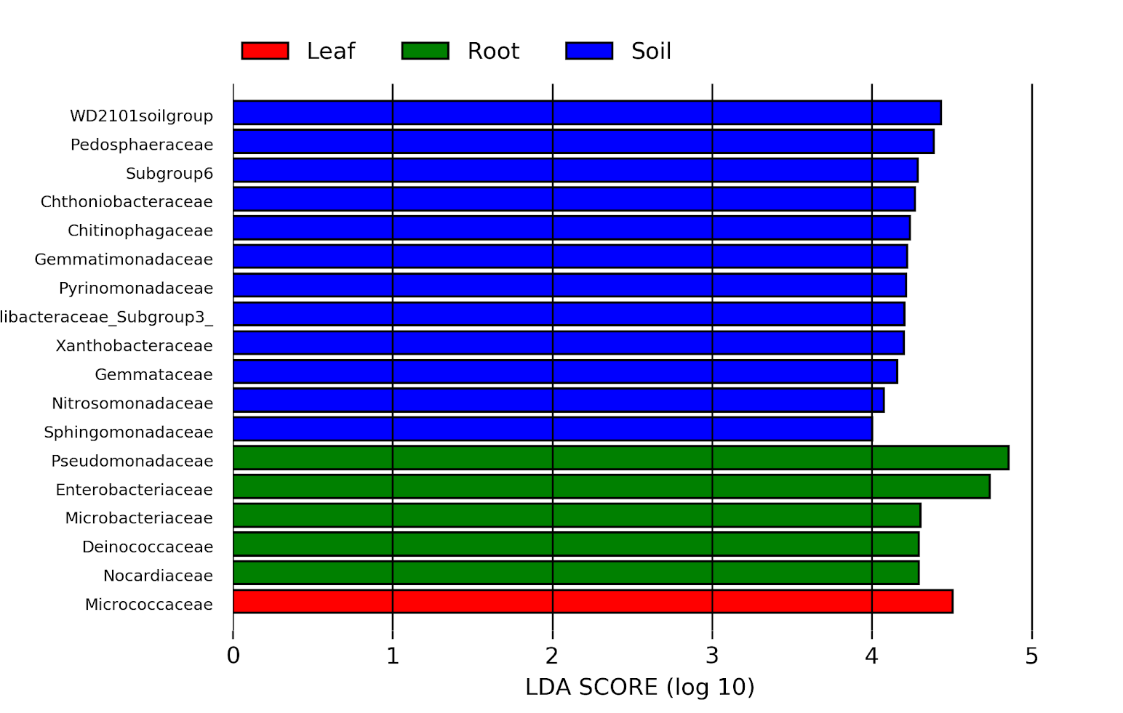
(D4) TN+Controls AGSize & Compartment
Notes:
When we see a bacteria “hit” (e.g. Pedosphaeraceae) it means that entity has more abundance in one AGSize compared to another, but the graph doesn’t tell us which in which AGSize it has significant community abundance because it’s 1 dimensional
Can download these as tables (.csv files) and play with it in other programs too

Slide 7
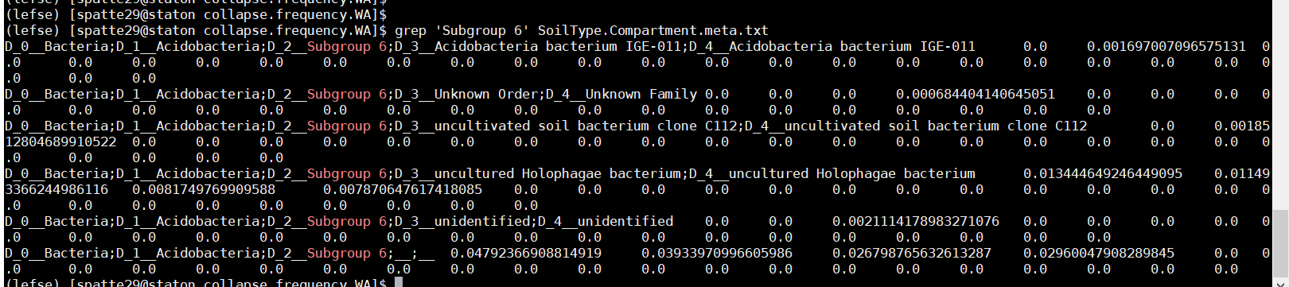
Subgroup 6 LefSe Results

